Slide 1
The JANES corpus of Slovene user-generated content
Darja Fišer
University of Ljubljana
Jožef Stefan Institute
„Digitale Diskurse – kontrastive Aspekte“
Ljubljana, 27 September 2018

Slide 2
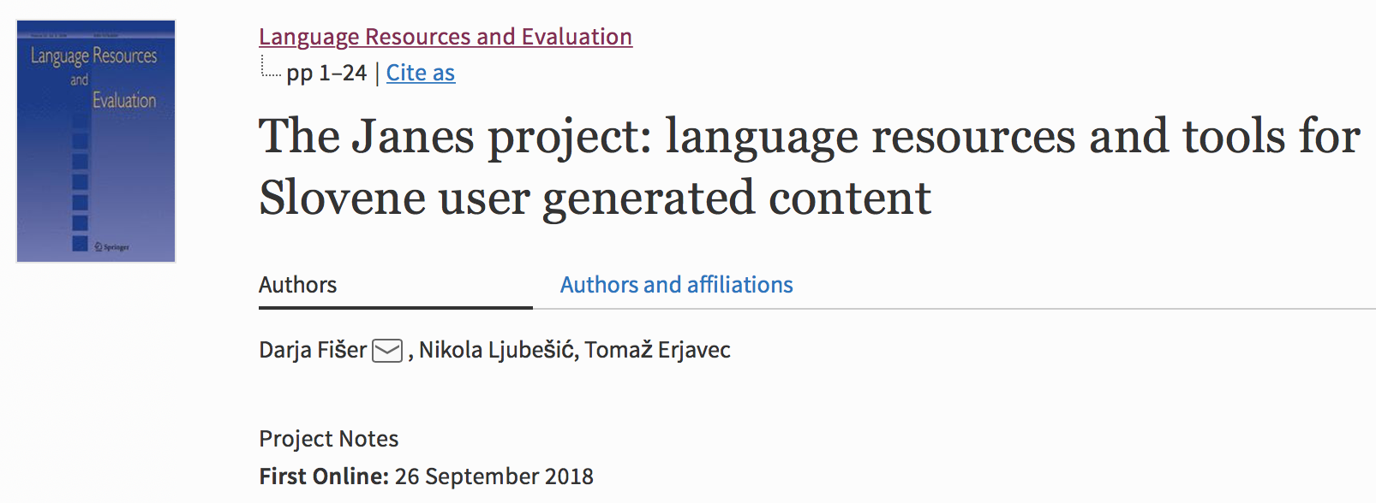

Slide 4
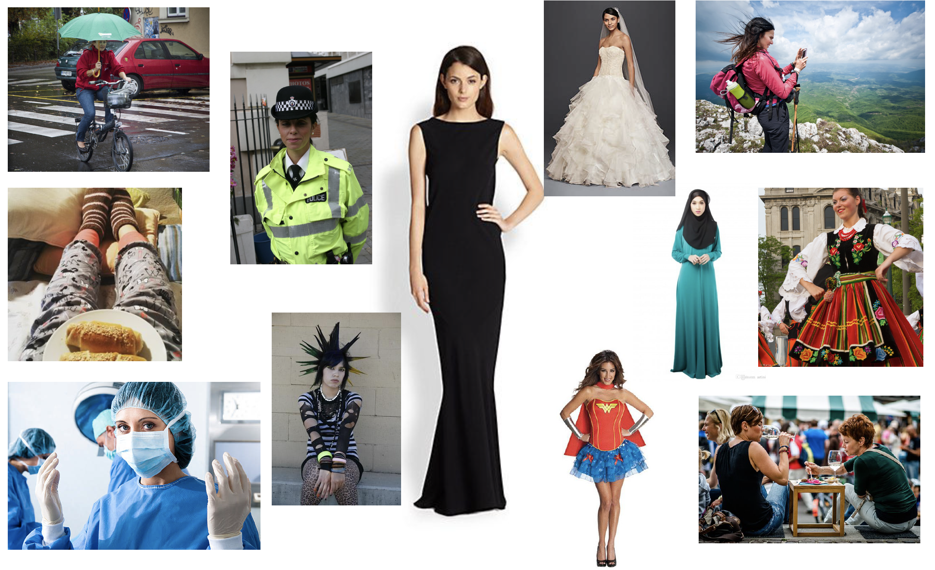

Slide 6
Research goals
The JANES project
national basic research project
3 yr, 2014-2017
2 institutions, 8 team members
http://nl.ijs.si/janes
WP1: Corpus construction
WP2: Linguistic analysis
Task 1: vs. standard Slovene
orthography (spelling, capitalization, punctuation)
regional variation
shortening strategies
syntax
Task 2: vs. spoken Slovene
discourse markers
interactive elements
Task 3: collocations
new collocations of old words
collocations of new words
dictionary of Twitterese
Task 4: terminology
specialisation level & density
nonstandard elements in terminology
Task 5: semantic shifts
sense expansion/narrowing/shifting
amelioration/pejoration
neologisms
Task 6: offensive language
refugee crisis
gay marriage
WP3: NLP tools

Slide 7
Tweets
TweetCat (Ljubešić et al. 2014)
Slovene-specific seed words -> Slovene users -> their network
metadata: username, time stamp, no. of retweets & favourites
še, kaj, že, če, ampak, mogoče, jutri, zdaj, vendar, kje, oziroma, tudi, sploh, spet, všeč, ravnokar, končno, kdaj, preveč & očitno

Slide 8
Forums
3 forums: med.over.net, avtomobilizem.com, kvarkadabra.net
customized extractors
metadata: topic, post URL, post time stamp, username, post id

Slide 9
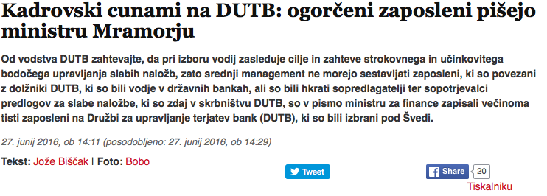
News & news comments
3 news portals: RTV Slo, Mladina, Reporter
customized extractors
metadata: article url, article id, username, post time stamp, post id

Slide 10
Blog posts & blog comments
2 blog sites: publishwall.si, rtvslo.si
customized extractors
metadata: post URL, post time stamp, username, post id

Slide 11
Wikipedia talk & user pages
Wikitalk extractor (Ljubesic 2016)
based on language-specific codes for username (“uporabnik”) & language (“sl”)
minimalistic post segmentation

Slide 12
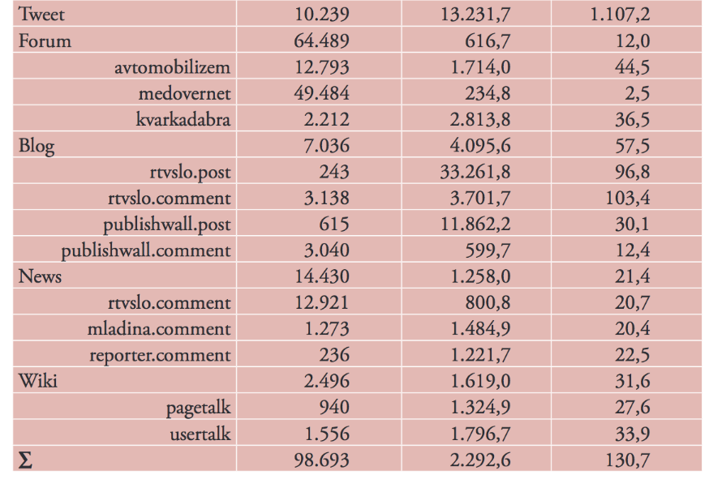
Janes in numbers
No. of words/user
No. of texts/user
Text type
No. of users

Slide 13
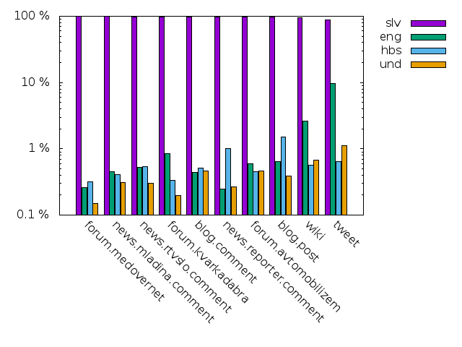
Language of texts

Slide 14
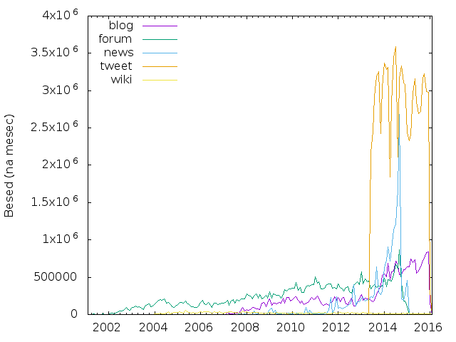
Age of texts

Slide 15
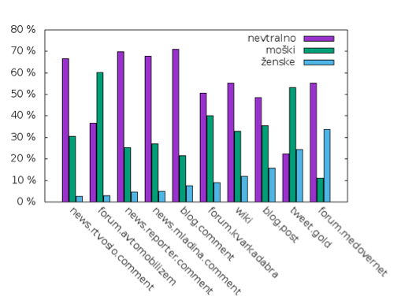
Types of users
Gender of users
manual annotation for Twitter & blogs
automatic annotation for the rest
Types of users on Twitter
manual annotation
private: 76%
corporate: 24%
84% undefined
13% male
3% female

Slide 16
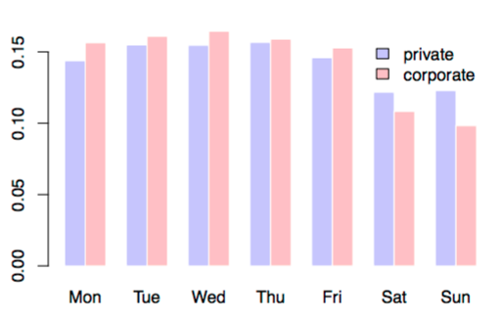
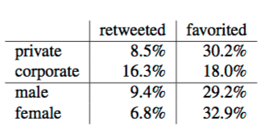
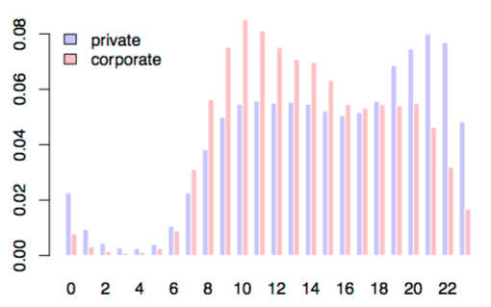
Corporate vs. private users

Slide 17
Region of users
Region of users on Twitter (Čibej & Ljubešić 2015)
automatic annotation
22% of all users
2% of all tweets
7 regions

Slide 18
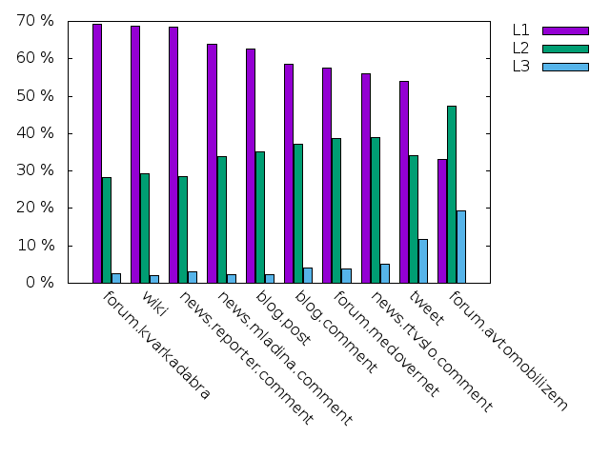
Text standardness
automatic annotation
Ljubešić et al. 2015

Slide 19
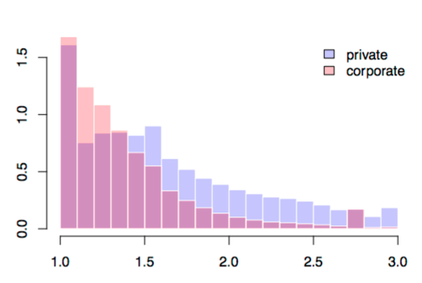
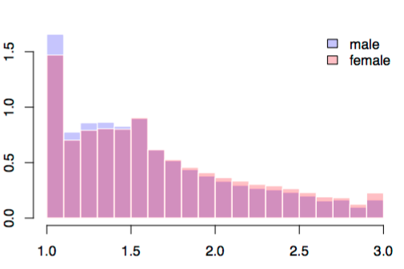
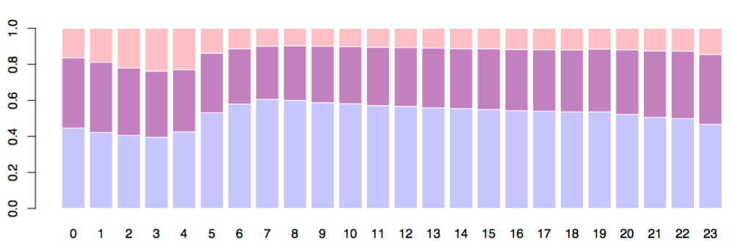
Text standardness on Twitter

Slide 20
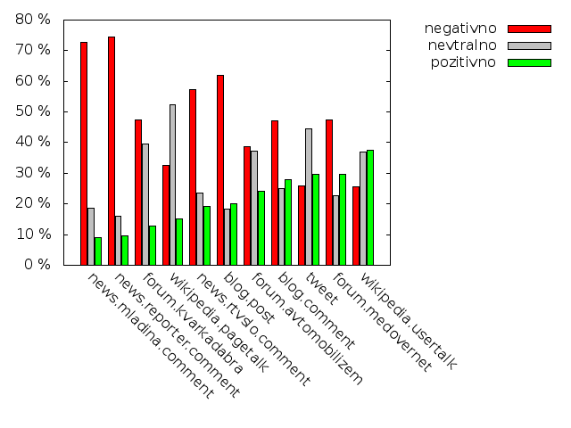
Text sentiment
automatic annotation
Smailović 2014

Slide 21
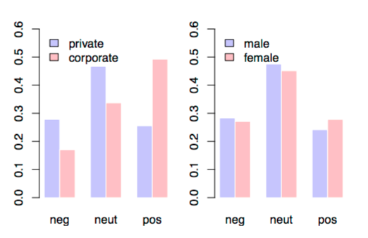
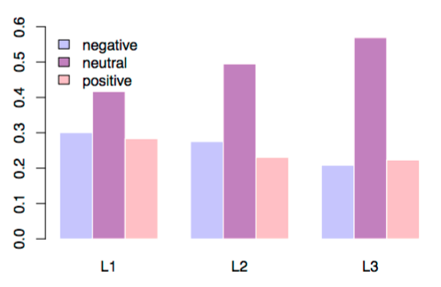
Sentiment on Twitter

Slide 22
Spelling practices in UGC
quantitative analysis of instances of non-standard spelling found on Slovene Twitter
on manually normalized, lemmatized and part-of-speech tagged tweets
transformations in non-standard forms
deletions
insertions
replacements

Slide 23
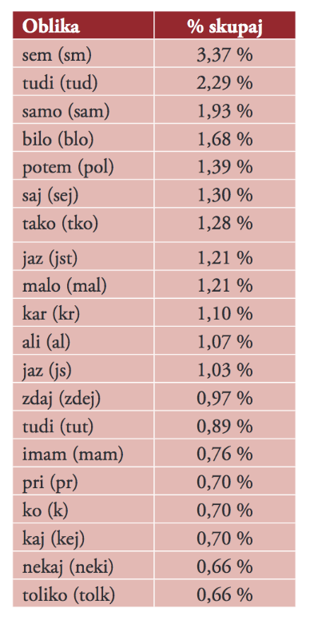
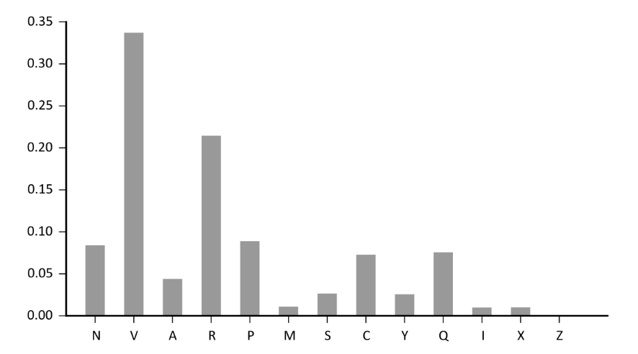
Spelling practices in UGC
results
most transformations in lexical words
within PoS classes, function words are transformed to a greater extent
deletions are the most common transformation type
mostly take the form of vowel deletions at word end

Slide 24
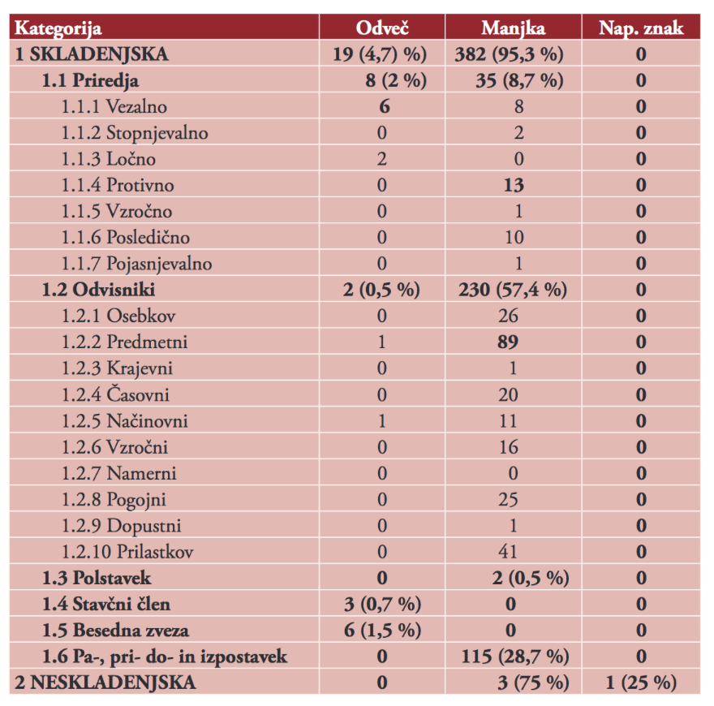
Comma usage in UGC
comma placement in Slovenian tweet
compliance with standard Slovene
in what circumstances comma placement deviates
mostly missing
mostly in subordinate clauses
problematic rules for some constructions

Slide 25
UGC vs. spoken Slovene
stereotype: hybrid between spoken & written
analysis
features of written, spoken & CMC discourse
key-word forms in the corpora Kres, Gos & Janes
results
at PoS level CMC is closer to standard written l.
forum posts most written-like
tweets & news comments with positive sentiment least written-like
at lexical level inter-speaker interactive elements that are typical of spoken discourse
most frequent in tweets & news comments

Slide 26
Semantic shifts in UGC
using Twitter to monitor lexicographic novelties
using distributional modeling of words to compare the target word’s semantic profiles
reference & twitter corpus
typology of identified semantic shifts
results:
noise due to pre-processing errors in both corpora
semantic shifts triggered by daily events
semantic shifts due to informal communication circumstances

Slide 27
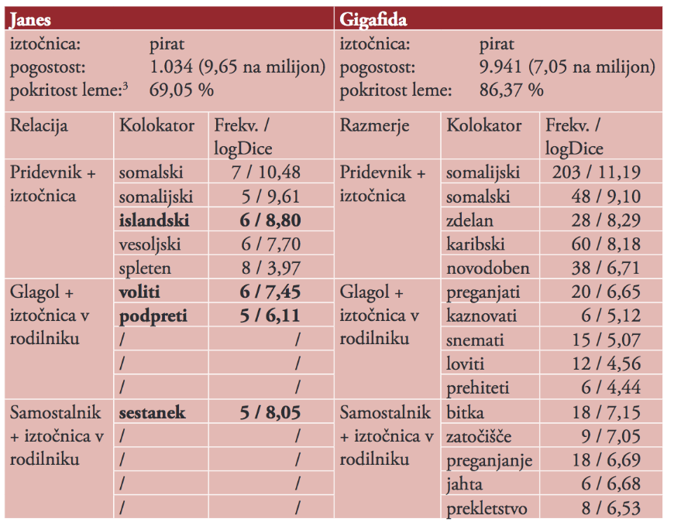
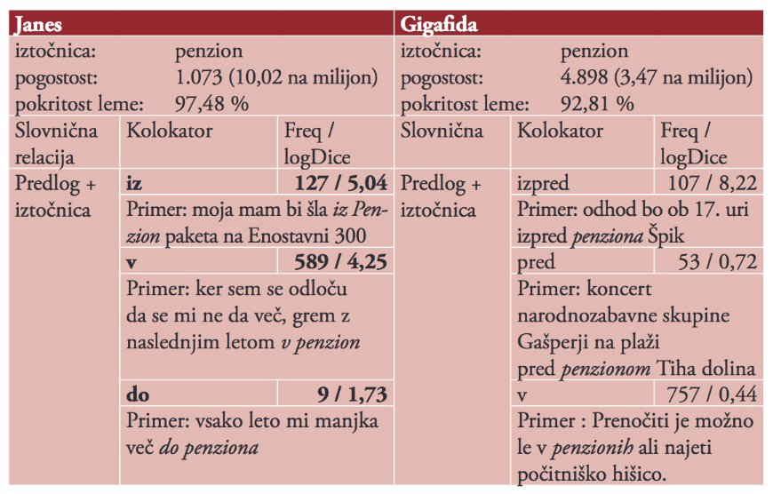
Semantic shifts in UGC

Slide 28
Code-switching in UGC
uf, good luck. jst sm red velvet kapkejke jedla. biskvit, pofarban na rdeč. ne štekam hajpa razn tega da je pretty.
5-level annotation scheme
language and type of CS
orthographic and morphologic assimilation of code-switches
part of speech

Slide 29
Code-switching in UGC
quantitative analysis
CS is not a rare phenomenon
intrasentential CS is more common, 50% of single-word switches
closed-class words also appear as code-switches
English clearly dominates
most code-switches keep the orthographic and morphologic features of the source language
qualitative analysis
CS fulfils various discourse functions: referential, expressive, phatic
CS semantic fields: pop culture (TV shows, sport, food, Twitter)
CS phraseology: many idiomatic expressions, phrasal verbs, collocations , proverbs

Slide 30
Corpus processing
Sentence segmentation & tokenization (Ljubešić in Erjavec 2016)
combination of classic & optional regex rules for non-standard language
evaluation: T - very good (99.2%), S - room for improvement (86.3%)
Rediacritization (Ljubešić in dr. 2016)
Problem je resen.
translation model + language model
evaluation: Wikipedia 99.62%, tweets 99.12%
Normalization
jest, jst, jas, js -> jaz
character-based machine translation
manually annotated training set: 4.000 tweets, 100.000 words
MSD tagging & lemmatization (Ljubešić in Erjavec 2016)
new tags for CMC-specific elements (e-mails, URLs, emoji, hashtags, mentions)
conditional random fields & lexicon used as a feature
evaluation: 94.3%, error reduction 25%
Encoding
bespoke XML for metadata
annotated text in TEI P5

Slide 31
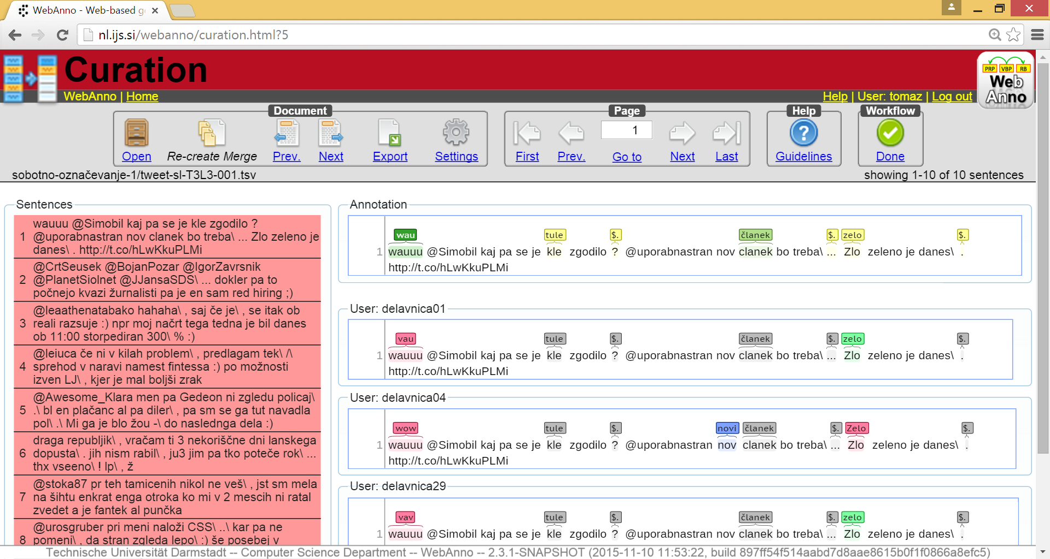
Manual annotation of the Janes reference corpus
Goals
tokenization & sentence splitting
standardization
POS-tagging & lemmatization
WebAnno
Annotation guidelines
Annotator training
Curation

Slide 32
http://nl.ijs.si/janes/
tenks ☺

