Slide 1
CLARIN:
European Research Infrastructure for Language Resources and Technology
Tomaž Erjavec
Dept. Of Knowledge Technologies
Jožef Stefan Institute
Language Technologies
http://nl.ijs.si/et/teach/mps17-hlt/
MPŠ, 5. 4. 2017

Slide 2
Overview of the lecture
Introduction
Research Infrastructure CLARIN(.SI)
CLARIN.SI Repository

Slide 3
Language Resources
Corpora:
Uniformly encoded and documented collections of texts
Text chosen according to explicit criteria
Annotated
Reference/specialised; mono-/multi-lingual; written/spoken
Lexicons:
The vocabulary of a language
Words / phrases
Morphology, syntax, semantics, translations, links
Models:
Data for programs that enables them to annotate text in a particular language for some level of analysis
E.g. CLOG model for lemmatisation of Slovene; Moses model for translating Slovene to English

Slide 4
Re-use
Classic approach:
Language resources are created for each research project separately
The resources are not available to other researchers
Disadvantages:
Constructing a language resource can be very costly: if this is done again and again this means great loss of time and money
Other researchers cannot validate or improve upon earlier results
Help maintain the monopoly of researchers or institutions that produced the resource
The resources cannot be used to develop products

Slide 5
Open access to the results of research projects
Without barriers to publications and data:
Saves money and time;
Avoids duplication of work;
Increases cooperation;
Greater transparency of the scientific process;
Stimulates innovation.
Strong trend in the EU (H2020)
Somewhat slower also in Slovenia

Slide 6
Research infrastructures
„Research infrastructures“ refers to facilities, resources and related services used by the scientific community to conduct top-level research in their respective fields.

Slide 7
Research infrastructures
EU ESFRI (European Strategy Forum on Research Infrastructures) established in 2002
Roadmap: proposed 15 (2016: 21) RI, some are already established as ERIC (European RI Consortium) EU legal entity
Slovenia contributes to 14 IR (e.g. CERN)
Humanities and Social Sciences:
DARIAH ERIC / DARIAH-SI: Digital Research Infrastructure for the Arts and Humanities
CLARIN ERIC / CLARIN.SI: Common Language Resources and Technology Infrastructure

Slide 8
Common Language Resources and Technology Infrastructure
Dedicated to long-term solutions and technology services for deploying, connecting, analysing and sustaining digital language data and tools
A new paradigm for cooperation in development of language resources and tools
Action points:
Make existing solutions available in a common infrastructure,
Enable consultacy and teaching on how to tailor tools and resources to specific research needs,
Contribute to standardisaton of resources and tools

Slide 9
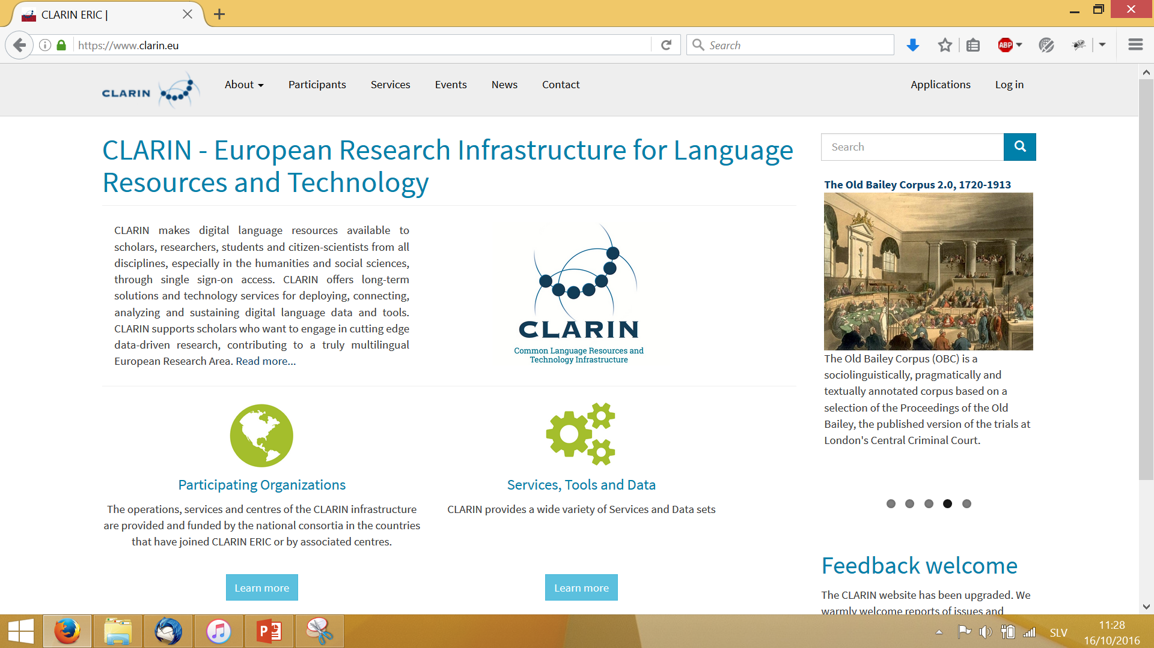
CLARIN ERIC
19 member countries + France and UK as observers
Based in the Netherlands
Leading the IR, support staff, working groups
Annual conferences
Virtual Language Observatory
Most work performed inside national consortia

Slide 10
Established end of 2013, JSI coordinator
Organised as a consortium of 12 partners: 4x university, 3x research institute, 3x society, 2x company
Suppors events: CMC 2016, JTDH 2016, ..
Repository:
Language resources
(and tools)
Web utilities:
Concordancers (corpus analysis)
Manual annotation (developing training corpora)
Workflows (automatic annotation)

Slide 11
Stable in secure platform (Nagios, mirror, https, …)
Explicit terms of use (licenses, code of conduct) Infrastructure for authentication and authorisation
Permanent identifiers
Standard encoding of metadata (DC, CMDI)
Metadata export (OAI-PMH): CLARIN VLO, re3data, ...

Slide 12
Single Sign-On
Single Sign-On: separation between service and identity providers
Infrastructure for authentication and authorisation (AAI)
As opposed to standard web registration the identity of the user is known
Federations of Identity Providers
EduGain: connects federations of IPs to simplify access to content and services for a global research and education community
Slovene users can use most of CLARIN services in the EU (e.g. WebLicht)

Slide 13
Handles
Problem of stable URLs that can be safely cited
Most popular solution: DOI
CLARIN uses the Handle system
Registration (& payment), obtaining a prefix, installation of local software
http://hdl.handle.net/11356/1044 → https://www.clarin.si/repository/xmlui/handle/11356/1044

Slide 14
Metadata
<cmd:CMD xmlns:cmd="http://www.clarin.eu/cmd/" xmlns:olac="http://www.clarin.eu/cmd/" xmlns:ms="http://www.clarin.eu/cmd/" xmlns:xsi="http://www.w3.org/2001/XMLSchema-instance" CMDVersion="1.1" xsi:schemaLocation="http://www.clarin.eu/cmd/ http://catalog.clarin.eu/ds/ComponentRegistry/rest/registry/profiles/clarin.eu:cr1:p_1403526079380/xsd">
<cmd:Header>
<cmd:MdCreationDate>2016-04-14</cmd:MdCreationDate>
<cmd:MdSelfLink>http://hdl.handle.net/11356/1039@format=cmdi</cmd:MdSelfLink>
<cmd:MdProfile>clarin.eu:cr1:p_1403526079380</cmd:MdProfile>
<cmd:MdCollectionDisplayName>CLARIN.SI data &amp; tools</cmd:MdCollectionDisplayName>
</cmd:Header>
<cmd:Resources>
<cmd:ResourceProxyList>
<cmd:ResourceProxy id="lp_1563">
<cmd:ResourceType>LandingPage</cmd:ResourceType>
<cmd:ResourceRef>http://hdl.handle.net/11356/1039</cmd:ResourceRef>
</cmd:ResourceProxy>
<cmd:ResourceProxy id="uri_1">
<cmd:ResourceType mimetype="text/html">Resource</cmd:ResourceType>
<cmd:ResourceRef>http://eng.slovenscina.eu/sloleks/opis</cmd:ResourceRef>
</cmd:ResourceProxy>
</cmd:ResourceProxyList>
<cmd:JournalFileProxyList/>
<cmd:ResourceRelationList/>
</cmd:Resources>
<cmd:Components>
<cmd:LINDAT_CLARIN>
<cmd:bibliographicInfo>
<cmd:projectUrl>http://eng.slovenscina.eu/sloleks/opis</cmd:projectUrl>
<cmd:titles>
<cmd:title xml:lang="en">Morphological lexicon Sloleks 1.2</cmd:title>
</cmd:titles>

Slide 15
Repository CLARIN.SI
Based on DSpace + CLARIN LINDAT
AAI, Handle, branding, (partial) localisation
GitHub
Used by: Czech, Slovenia, Poland, Norway, Italy
Administration, logs, …
PIWIK, curation checks
Supports various licences

Slide 16
Administration

Slide 17
Repository: uploading a new resource
Log-in with AAI
Rather simple workflow
Choice of licence
Possible to share the submission process
The submission is checked by one of the CLARIN.SI editors
Can embargo the submission
Can supersede a submission with a newer one

Slide 18
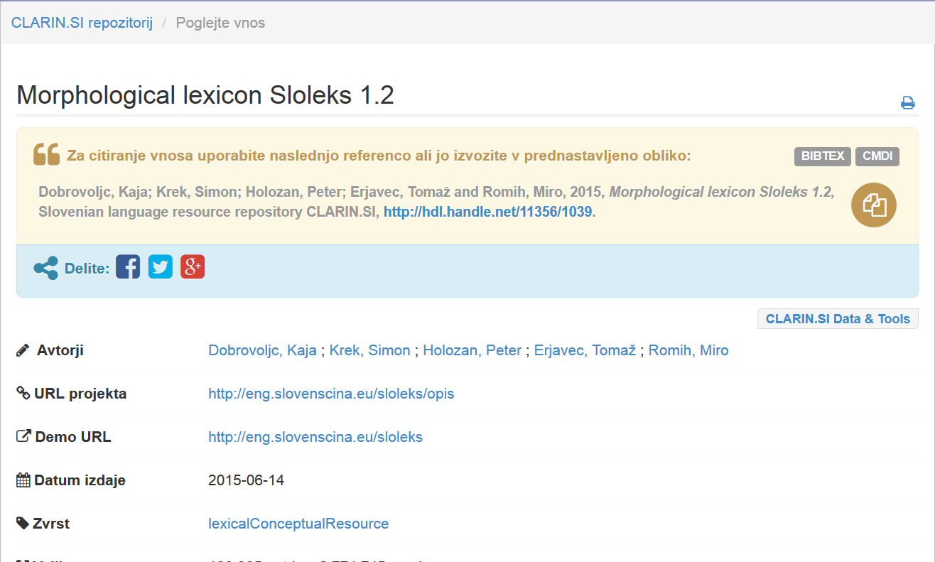
Repozitorij: download
Most of CLARIN.SI resources are CC
Others: AAI login, accept the terms of use
Citation!

Slide 19
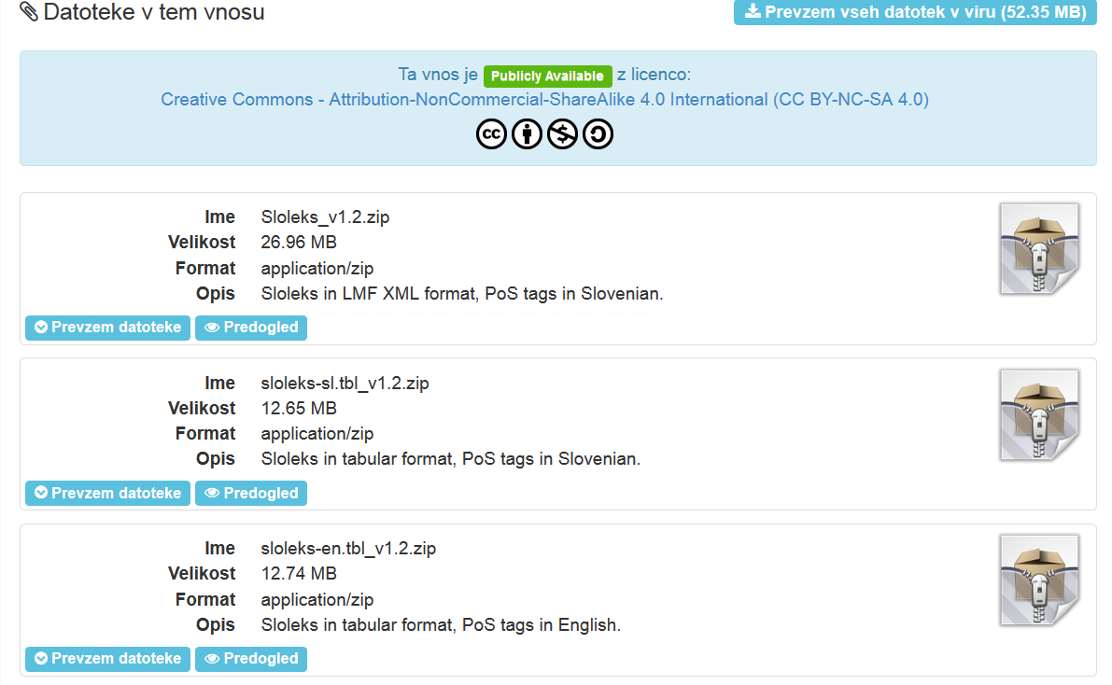
Data
XML using one of the „standard“ schemas
Text Encoding Initiative Guidelines (TEI P5)
For simple data a table is fine
+ derived formats + documentation
ZIP

Slide 20
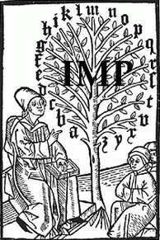
What is in the CLARIN.SI repository?
Annotated corpora: 38
MULTEXT-East, jp, fi, hr, sr, bs hr-en, fi-en WaCi, …
ccGigafida, ccKRES
jos1M, ssj500k, goo300k, …
SNABI, Gos, GosVL
IMP, Šolar, …
Tviti
(Janes, KAS)
Lexical resources: 14
MULTEXT-East, hrLex, srLex, jaSlo
SloLeks, sloWNet
N-grams
Emoji
More via CLARIN VLO
or Google..

