Slide 1
Language Technologies Tomaž Erjavec Dept. of Knowledge Technologies Jožef Stefan Institute
The Janes project
Module "Knowledge Technologies" Jožef Stefan International Postgraduate School 2016 / 2017

Slide 2
Janes project
National basic research project „Resources, Tools and Methods for the Research of Nonstandard Internet Slovene“ (J6―6842)
3 yr, 2014-2017
Lead: Dept. of Translation, Faculty of Arts, Uni. of Ljubljana (Darja Fišer)
Also: Jožef Stefan Institute, E8
8 team members
http://nl.ijs.si/janes

Slide 3
Research goals
WP1: Corpus construction
WP2: Linguistic analysis
Task 1: vs. standard Slovene
orthography (spelling, capitalization, punctuation)
regional variation
shortening strategies
syntax
Task 2: vs. spoken Slovene
discourse markers
interactive elements
Task 3: collocations
new collocations of old words
collocations of new words
dictionary of Twitterese
Task 4: terminology
specialisation level & density
nonstandard elements in terminology
Task 5: semantic shifts
sense expansion/narrowing/shifting
amelioration/pejoration
neologisms
Task 6: offensive language
refugee crisis
gay marriage
WP3: NLP tools

Slide 4
Constructing the Janes Corpus
First large corpus of Slovene user-generated content
5 text types of public user-generated content:
tweets
forum posts
user comments on on-line news portals
blog posts along with user comments on these blogs
talk and user pages from Wikipedia
Each text type harvested with specialised crawler:
identify texts to be harvested (URLs)
harvest
clean (character encoding, boilerplate)
structure (e.g. threads in forums)
add basic metadata (time of post, user/author)
add additional metadata

Slide 5
Tweets
TweetCat (Ljubešić et al. 2014)
Twitter API
Slovene-specific seed words -> Slovene users -> their network
metadata: username, time stamp, no. of retweets & favourites
še, kaj, že, če, ampak, mogoče, jutri, zdaj, vendar, kje, oziroma, tudi, sploh, spet, všeč, ravnokar, končno, kdaj, preveč & očitno

Slide 6
Forums
3 forums: med.over.net, avtomobilizem.com, kvarkadabra.net
customized extractors (Beautiful Soup)
metadata: topic, post URL, post time stamp, username, post id
preserve structure of threads

Slide 7
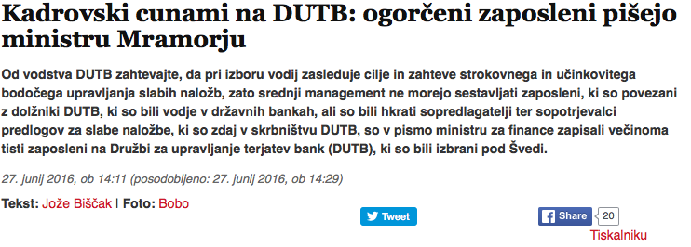
News & news comments
3 news portals: RTV Slo, Mladina, Reporter
customized extractors (Beautiful Soup)
metadata: article url, article id, username, post time stamp, post id
keep news article and comment thread

Slide 8
Blog posts & blog comments
2 blog sites: publishwall.si, rtvslo.si
customized extractors (Beautiful Soup)
metadata: post URL, post time stamp, username, post id
keep blog and comment thread

Slide 9
Wikipedia talk & user pages
Wikitalk extractor (Ljubešić 2016)
use dump of Wikipedia
based on language-specific codes for username (“uporabnik”) & language (“sl”)
minimalistic post segmentation

Slide 10
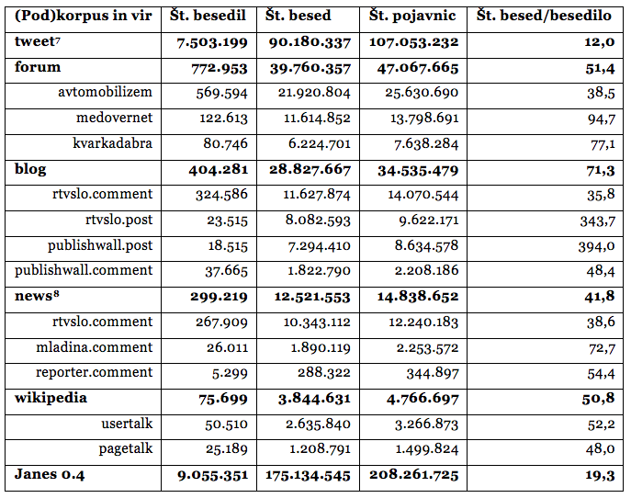
Janes corpus in numbers

Slide 11
Metadata in the Janes corpus
Metadata = data about data, i.e. data on texts
Allows much more interesting analyses
Some extracted directly from harvested documents (e.g. number of retweets)
Some extracted with simple heuristics (username, date of post)
Some added manually (sex & type of user)
Some added with machine learning methods (standardness, sentiment)

Slide 12
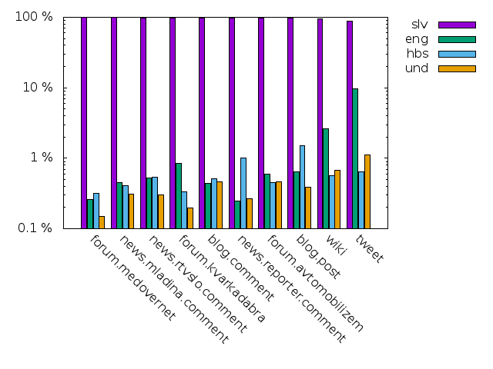
Language of texts
langid.py + heuristics

Slide 13
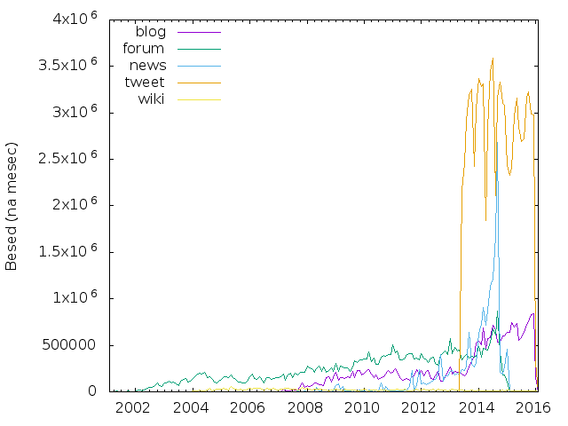
Age of texts

Slide 14
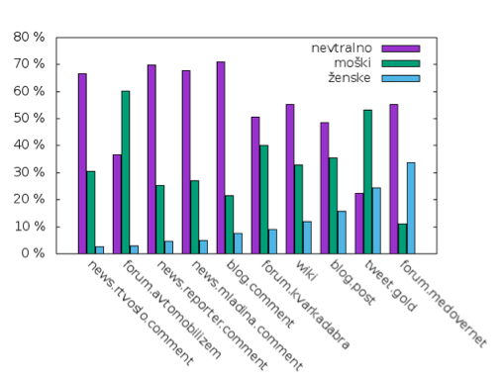
Types of users
Gender of users
manual annotation
only for Twitter & blog posts
Types of users on Twitter
manual annotation
private: 76%
corporate: 24%
84% neutral
13% male
3% female

Slide 15
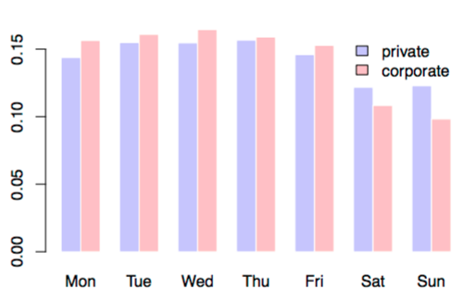
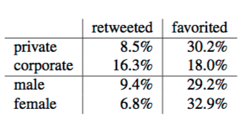
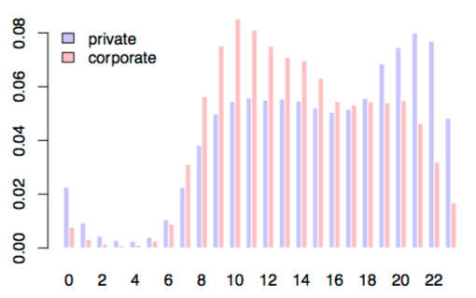
Corporate vs. private users

Slide 16
Region of users
Region of users on Twitter (Čibej & Ljubešić 2015)
automatic annotation
22% of all users
2% of all tweets
7 regions

Slide 17
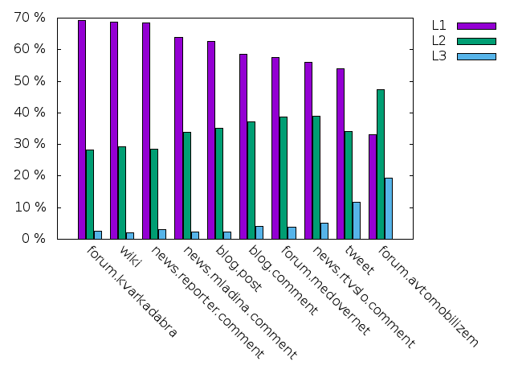
Text standardness

Slide 18
Text standardness
Training dataset
Manual annotation, 1 day hackathon, 6 students
900 texts single annotated (development set)
400 texts double-annotated (testing set)
Feature selection (29 features)
character-based:
repetitions of characters
ratio of alphabetic vs. non-alphabetic characters
ratio of vowels vs. consonants
token-based:
proportion of very short words
proportion capitalised words
proportion of words not included the Sloleks lexicon
Regressor
grid search hyperparameter optimisation via 10-fold cross-validation on the SVR regressor using RBF kernel
Evaluation
mean absolute error: 0.377 T, 0.424 L

Slide 19
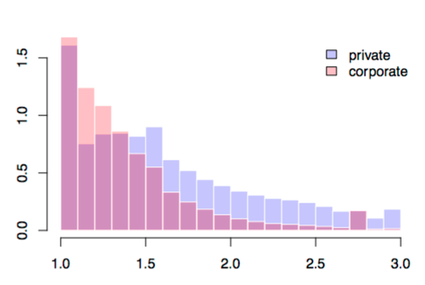
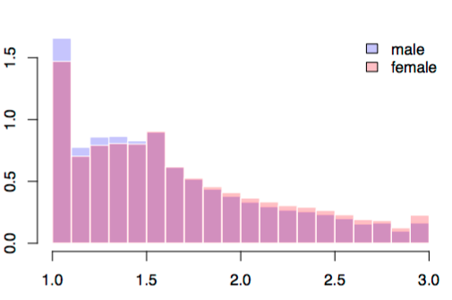
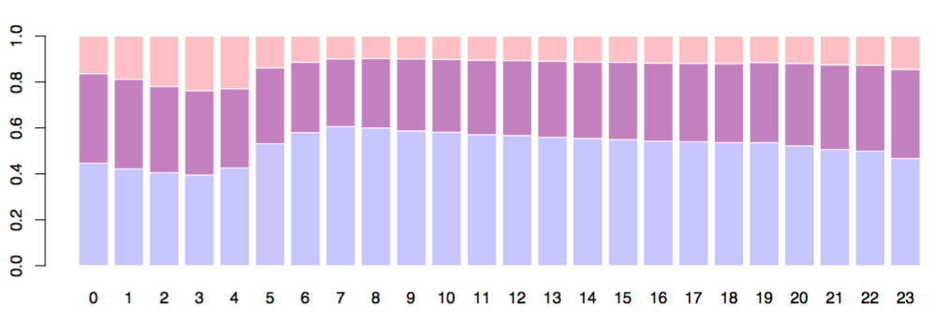
Text standardness on Twitter

Slide 20
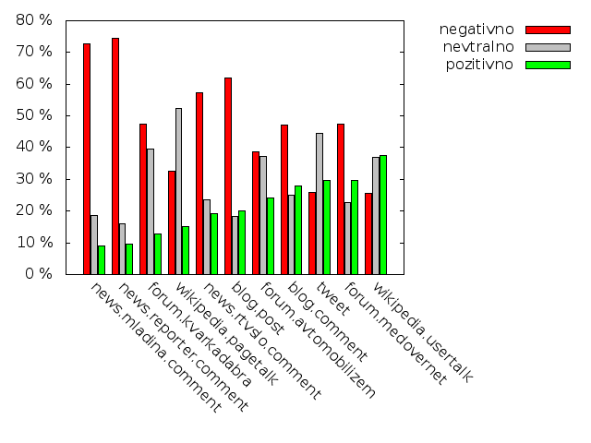
Text sentiment
automatic annotation with SVM
large manually labelled Twitter dataset
Smailović 2014

Slide 21
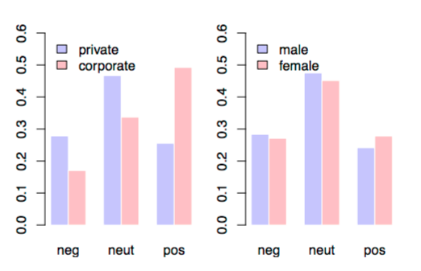
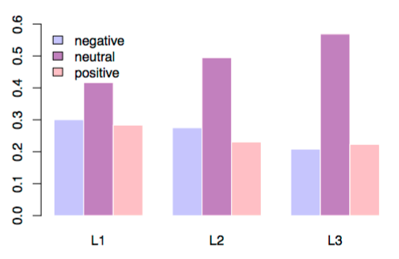
Sentiment on Twitter

Slide 22
Linguistic processing
Sentence segmentation & tokenization
To je ok. → To + ␣ + je + ␣ + ok + .
Rediacritization
On se se vedno rezi! → On se še vedno reži!
Normalization
jest, jst, jas, js → jaz
Tagging & lemmatization
časa → Ncmsg + čas

Slide 23
Linguistic processing 1.
Tokenization & sentence segmentation
Token: one occurrence of a word or punctuation symbol
Typically first tool to apply to text
More difficult than it looks, esp. for non-standard text:
Hello, Mr. President!
moram tukaj pisati? :-)no se bom mal opisala pač tko..kokrkol :-)
Combination of classic & optional regex rules for non-standard language
Evaluation:
token - very good (99.2%)
sentence - room for improvement (86.3%)

Slide 24
Linguistic processing 2.
Rediacritization
In general difficult:
Out-of-Vocabulary words
Ambiguous words: Problem je resen.
(Ljubešić in dr. 2016)
Machine learning approach: KenLM
Easy to acquire training data: strip diacritic from regular corpus
Translation model + Language model (context!)
Evaluation: Wikipedia 99.62%, tweets 99.12%

Slide 25
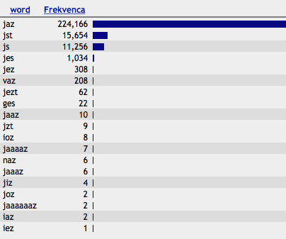
Linguistic processing 3.
Normalization
Standardise non-standard words in text
Character-based statistical machine translation
Manually annotated training set: 4.000 tweets, 100.000 words

Slide 26
Linguistic processing 5.
MSD tagging & lemmatization
Performed on normalised text
Use of MULTEXT-East MSD tagset for Slovene (1900 tags)
New tags for CMC-specific elements (e-mails, URLs, emoji, hashtags, mentions)
(Ljubešić in Erjavec 2016)
Conditional random fields & lexicon used as a feature
Trained on ssj500k manually annotated corpus
Evaluation: 94.3%,
Error reduction to previous best result: 25%

Slide 27
Corpus Encoding
Janes XML schema for structure and metadata
<wikipedia xml:id="janes.wikipedia.pagetalk">
<page xml:id="janes.wikipedia.pagetalk.1"
url = "https://sl.wikipedia.org/wiki/Pogovor:Glavna_stran/Arhiv_junij_2006">
<title>Pogovor:Glavna stran/Arhiv junij 2006</title>
<topic xml:id="janes.wikipedia.pagetalk.1.1">
<title>Pogovor:Glavna stran/Arhiv junij 2006</title>
<comment xml:id="janes.wikipedia.pagetalk.1.1.1" xml:lang="slv"
std_tech="T1" std_tech_n="1.6" std_ling="L1" std_ling_n="1.3"
sentiment="neutral">
<text>
<p xml:id="janes.wikipedia.pagetalk.1.1.1.1">O vsebinah glavne strani
se dogovarjamo na Wikipedija:Glavna stran.</p>

Slide 28
Linguistic annotation
Text in XML according to TEI P5

Slide 29
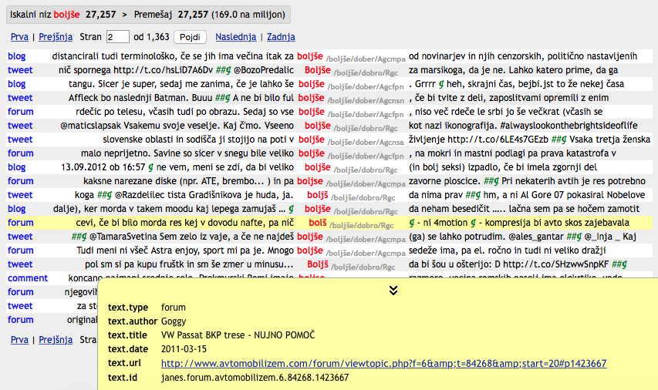
Janes in (no)SketchEngine

Slide 30
Manual annotation of the Janes reference datasets
Goals:
Manually annotated datasets are needed for machine learning of annotation tools and their testing
Also need for corpus-based linguistic investigations where results of automatic methods are to imprecise or automatic methods do not even exists
Results for ML of linguistic annotation (already available in CLARIN.SI):
Janes-Norm: tokenization, sentence splitting, normalisation
Janes-Tag: MSD tagging and lemmatisation
Janes-Syn: syntactic annotation
Results for linguistic investigations:
Janes-Kratko: shortening strategies in tweets
Janes-Vejica: placement of comma in tweets
Janes-Preklop: code-switching in tweets
Annotation campaigns
Annotation guidelines
Annotator training
Annotation
Curation
Export to TEI

Slide 31
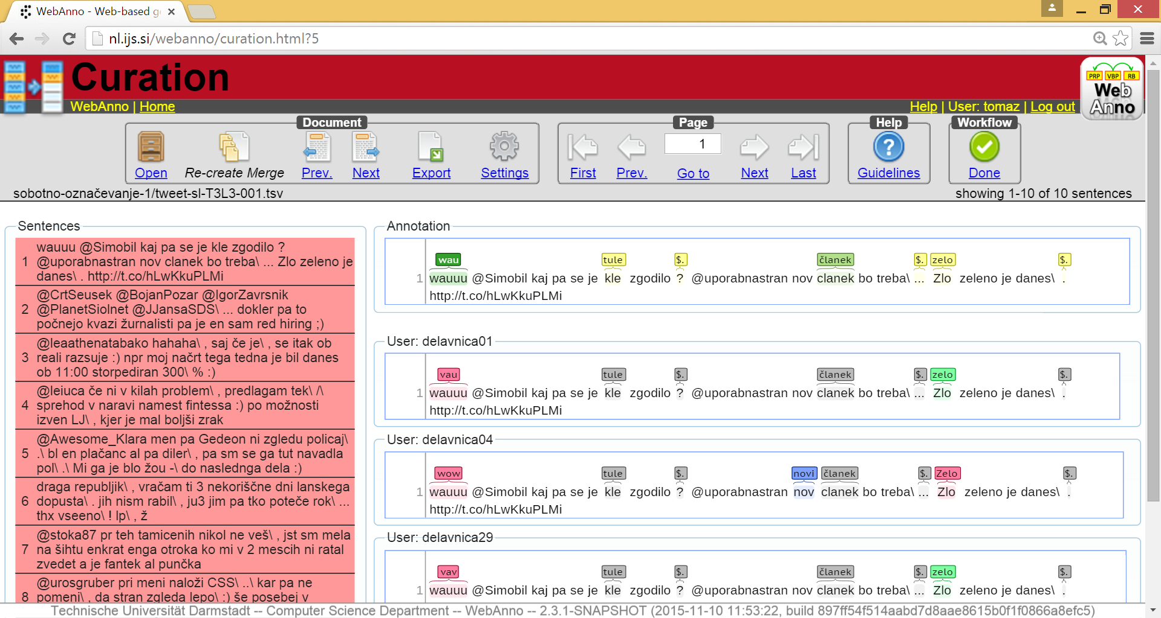
Manual annotation in WebAnno

Slide 32
Further work
Corpus enhancement
encoding enhancement (document structure, CMC-specific)
monitor corpus (Twitter)
Small dictionary of Twitterese
Corpus dissemination
problems (terms of user, copyright, privacy)
solutions (anonymization, shuffling, sampling)

Slide 33
More on http://nl.ijs.si/janes/

