Slide 1
Language Technologies Tomaž Erjavec Dept. of Knowledge Technologies Jožef Stefan Institute
Module "Knowledge Technologies" Jožef Stefan International Postgraduate School 2016 / 2017

Slide 2
Lecturer info
tomaz.erjavec@ijs.si
http://nl.ijs.si/et/
Work:
development of language resources, mostly for Slovene
linguistic annotation, linguistic annotation standards
digital humanities (complex digital editions)
Research infrastructure for langauge resources and tools CLARIN.SI
Course homepage: http://nl.ijs.si/et/teach/mps17-hlt/

Slide 3
Course structure and assessment
Today: Introductory Lecture
Next slot: April 5th
Presentation of some topics for students: current projects & available (Slovene) datasets
Or (semi)finished projects by students: can do the work before!

Slide 4
Assessment
„Project“ work on topic connected with HLT (or corpus linguistics)
½ quality of work
½ quality of report
Can be joint work of 2 students
submission of seminar: February .. May (June):
Make appointments for consultations by email

Slide 5
Overview of the lecture
Computer processing of natural language
Applications
Some levels of linguistic analysis
Language corpora

Slide 6
I. Computer processing of natural language
Computational Linguistics:
a branch of computer science, that attempts to model the cognitive faculty of humans that enables us to produce/understand language
Natural Language Processing:
a subfield of CL, dealing with specific computational methods to process language
Human Language Technologies:
(the development of) useful programs to process language

Slide 7
Languages and computers
How do computers “understand” language?
AI-complete:
To solve NLP, you’d need to solve all of the problems in AI
Turing test
Engaging effectively in linguistic behavior is a sufficient condition for having achieved intelligence.
…but little kids can “do” NLP…

Slide 8
Problems
Languages have properties that humans find easy to process, but are very problematic for computers:
Ambiguity: many words, syntactic constructions, etc. have more than one interpretation
Vagueness: many linguistic features are left implicit in the text
Paraphrases: many concepts can be expressed in different ways
Humans use context and background knowledge; both are difficult for computers

Slide 9
Ambiguity
I scream Ice cream
It's very hard to recognize speech. It's very hard to wreck a nice beach.
Squad helps dog bite victim.
Helicopter powered by human flies.
Jack invited Mary to the Halloween ball.
Tam stojita dve hiši. V hiši je toplo.

Slide 10
Structuralist and empiricist views on language
The structuralist approach:
Language is a limited and orderly system based on rules
Automatic processing of language is possible with rules
Rules are written in accordance with language intuition
The empirical approach:
Language is the sum total of all its manifestations
Generalisations are possible only on the basis of large collections of language data, which serve as a sample of the language (corpora)
Machine Learning: “data-driven automatic inference of rules”

Slide 11
Other names for the two approaches
Competence vs. performance
Competence: linguistic knowledge possessed by speakers of a language (“knowing” the language)
Performance: the production of actual utterances (“doing” something with the language)
Deductive vs. Inductive:
Deductive method: from the general to specific; rules are derived from axioms and principles; verification of rules by observations
Inductive method: from the specific to the general; rules are derived from specific observations; falsification of rules by observations

Slide 12
Problems with the structuralist approach
Disadvantage of rule-based systems:
Coverage (lexicon)
Robustness (ill-formed input)
Speed (polynomial complexity)
Preferences (ambiguity: “Time flies like an arrow”)
Applicability (more useful to know what is the name of a company than to know the deep syntactic structure of a sentence)

Slide 13
Empirical approach
Describing naturally occurring language data
Objective (reproducible) statements about language
Quantitative analysis: common patterns in language use
Creation of robust tools by applying statistical and machine learning approaches to large amounts of language data:
Basis for empirical approach: corpora
For each language - also hand-annotated datasets
Empiricism supported by
rise in processing speed and storage,
advances in machine learning
the drastic increase in the availability of machine-readable texts
Increase in the availability of manually annotated datasets

Slide 14
II. HLT applications
Speech technologies
Machine translation
Question answering
Information retrieval and extraction
Text summarisation
Text mining
Dialogue systems
Multimodal and multimedia systems
Computer assisted: authoring; language learning; translating; lexicology; language research
Corpus linguistics

Slide 15
Machine translation
Perfect MT would require the problem of NL understanding to be solved first!
Types of MT:
Fully automatic MT (Google translate)
Human-aided MT (pre and post-processing)
Machine aided HT (translation memories)
Problem of evaluation:
automatic (BLEU, METEOR): not very good
manual: expensive

Slide 16
Rule based MT
Analysis and generation rules + lexicons
Problems: very expensive to develop, difficult to debug, gaps in knowledge
Option for closely related languages (Apertium)

Slide 17
Statistical MT
Parallel corpora: text in original language + translation
Texts are first aligned by sentences
On the basis of parallel corpora only: induce statistical model of translation
Noisy channel model, introduced by researchers working at IBM: very influential approach
Now used in Google translate
Open source: Moses
Difficult getting enough parallel text

Slide 18
Information retrieval and extraction
Information retrieval (IR) searching for documents, for information within documents and for metadata about documents.
“bag of words” approach: consider just the lexicon & frequency
Information extraction (IE) a type of IR whose goal is to automatically extract structured information, i.e. categorized and contextually and semantically well-defined data from a certain domain, from unstructured machine-readable documents.
Related area: Named Entity Recognition
In a text identify names (per, org, geo, misc), dates, numeric expression

Slide 19
III. Levels of linguistic analysis
Phonetics and phonology: speech synthesis and recognition
Morphology: morphological analysis, part-of-speech tagging, lemmatisation
Syntax: determining the constituent parts of a sentence and their syntactic function
Semantics: word-sense disambiguation, automatic induction of semantic resources (thesauri, ontologies)
Pragmatics: how context contributes to meaning (dialogue systems)
Translation: extracting translation equivalents from corpora, machine translation

Slide 20
Morphology
Studies the structure and form of words
Basic unit of meaning: morpheme
Morphemes pair meaning with form, and combine to make words: e.g. dog/Noun + -s/plural → dogs
Process complicated by exceptions and mutations
Morphology as the interface between phonology and syntax (and the lexicon)

Slide 21
Types of morphological processes
Inflection (syntax-driven): run, runs, running, ran gledati, gledam, gleda, glej, gledal,...
Derivation (word-formation): to run, a run, runny, runner, re-run, … gledati, zagledati, pogledati, pogled, ogledalo,...
Compounding (word-formation): zvezdogled, Herzkreislaufwiederbelebung

Slide 22
Inflectional Morphology
Mapping of form to (syntactic) function
dogs → dog + s / DOG [N,pl]
In search of regularities: talk/walk; talks/walks; talked/walked; talking/walking
Exceptions: take/took, wolf/wolves, sheep/sheep
English (relatively) simple; inflection much richer in e.g. Slavic languages

Slide 23
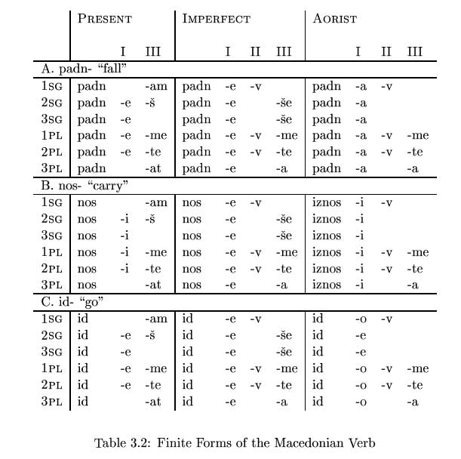
Macedonian verb paradigm

Slide 24
Syntax
How are words arranged to form sentences? *I milk like I saw the man on the hill with a telescope.
The study of rules which reveal the structure of sentences (typically tree-based)
A “pre-processing step” for semantic analysis
Common terms: Subject, Predicate, Object, Verb phrase, Noun phrase, Prepositional phr., Head, Complement, Adjunct,…

Slide 25
Example of a phrase structure and a dependency tree

