Slide 1
Language Technologies Module "Knowledge Technologies" Jožef Stefan International Postgraduate School Winter 2013 / Spring 2014
Introduction to Language Technologies
Tomaž Erjavec

Slide 2
Basic info
Lecturer: http://nl.ijs.si/et/ tomaz.erjavec@ijs.si
Work: language resources for Slovene, linguistic annotation, standards, digital libraries
Course homepage: http://nl.ijs.si/et/teach/mps13-hlt/

Slide 3
Assessment
Seminar work on topic connected with HLT
½ quality of work
½ quality of report
Today: intro lecture, presentation of some possible topics + choosing the topic by students
May / June: submission of seminar
Make appointments for consultations by email.

Slide 4
Overview of the lecture
Computer processing of natural language
Applications
Some levels of linguistic analysis
Language corpora

Slide 5
I. Computer processing of natural language
Computational Linguistics:
a branch of computer science, that attempts to model the cognitive faculty of humans that enables us to produce/understand language
Natural Language Processing:
a subfield of CL, dealing with specific computational methods to process language
Human Language Technologies:
(the development of) useful programs to process language

Slide 6
Languages and computers
How do computers “understand” language?
AI-complete:
To solve NLP, you’d need to solve all of the problems in AI
Turing test
Engaging effectively in linguistic behavior is a sufficient condition for having achieved intelligence.
…But little kids can “do” NLP…

Slide 7
Problems
Languages have properties that humans find easy to process, but are very problematic for computers:
Ambiguity: many words, syntactic constructions, etc. have more than one interpretation
Vagueness: many linguistic features are left implicit in the text
Paraphrases: many concepts can be expressed in different ways
Humans use context and background knowledge; both are difficult for computers

Slide 8
Ambiguity
I scream / ice cream
It's very hard to recognize speech. It's very hard to wreck a nice beach.
Squad helps dog bite victim. Helicopter powered by human flies.
Jack invited Mary to the Halloween ball.

Slide 9
Structuralist and empiricist views on language
The structuralist approach:
Language is a limited and orderly system based on rules.
Automatic processing of language is possible with rules
Rules are written in accordance with language intuition
The empirical approach:
Language is the sum total of all its manifestations
Generalisations are possible only on the basis of large collections of language data, which serve as a sample of the language (corpora)
Machine Learning: “data-driven automatic inference of rules”

Slide 10
Other names for the two approaches
Rationalism vs. empiricism
Competence vs. performance
Deductive vs. Inductive:
Deductive method: from the general to specific; rules are derived from axioms and principles; verification of rules by observations
Inductive method: from the specific to the general; rules are derived from specific observations; falsification of rules by observations

Slide 11
Problems with the structuralist approach
Disadvantage of rule-based systems:
Coverage (lexicon)
Robustness (ill-formed input)
Speed (polynomial complexity)
Preferences (ambiguity: “Time flies like an arrow”)
Applicability? (more useful to know what is the name of a company than to know the deep syntactic structure of a sentence)

Slide 12
Empirical approach
Describing naturally occurring language data
Objective (reproducible) statements about language
Quantitative analysis: common patterns in language use
Creation of robust tools by applying statistical and machine learning approaches to large amounts of language data
Basis for empirical approach: corpora
Empiricism supported by rise in processing speed and storage, and the revolution in the availability of machine-readable texts (WWW)

Slide 13
III. HLT applications
Speech technologies
Machine translation
Question answering
Information retrieval and extraction
Text summarisation
Text mining
Dialogue systems
Multimodal and multimedia systems
Computer assisted: authoring; language learning; translating; lexicology; language research

Slide 14
Machine translation
Perfect MT would require the problem of NL understanding to be solved first!
Types of MT:
Fully automatic MT (Google translate, babel fish)
Human-aided MT (pre and post-processing)
Machine aided HT (translation memories)
Problem of evaluation:
automatic (BLEU, METEOR)
manual (expensive!)

Slide 15
Rule based MT
Analysis and generation rules + lexicons
Problems: very expensive to develop, difficult to debug, gaps in knowledge
Option for closely related languages (Apertium)

Slide 16
Statistical MT
Parallel corpora: text in original language + translation
Texts are first aligned by sentences
On the basis of parallel corpora only: induce statistical model of translation
Noisy channel model, introduced by researchers working at IBM: very influential approach
Now used in Google translate
Open source: Moses
Difficult getting enough parallel text

Slide 17
Information retrieval and extraction
Information retrieval (IR) searching for documents, for information within documents and for metadata about documents.
“bag of words” approach
Information extraction (IE) a type of IR whose goal is to automatically extract structured information, i.e. categorized and contextually and semantically well-defined data from a certain domain, from unstructured machine-readable documents.
Related area: Named Entity Recognition
identify names, dates, numeric expression in text

Slide 18
Corpus linguistics
Large collection of texts, uniformly encoded and chosen according to linguistic criteria = corpus
Corpora can be (manually, automatically) annotated with linguistic information (e.g. PoS, lemma)
Used as datasets for
linguistic investigations (lexicography!)
training or testing of programs

Slide 19
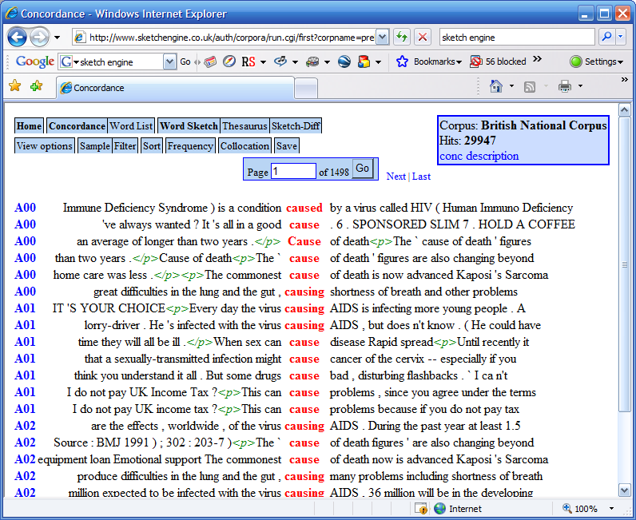
Concordances

Slide 20
Levels of linguistic analysis
Phonetics and phonology: speech synthesis and recognition
Morphology: morphological analysis, part-of-speech tagging, lemmatisation, recognition of unknown words
Syntax: determining the constituent parts of a sentence and their syntactic functio
Semantics: word-sense disambiguation, automatic induction of semantic resources (thesauri, ontologies)
Multilingual technologies: extracting translation equivalents from corpora, machine translation
Internet: information extraction, text mining, advanced search engines

Slide 21
Morphology
Studies the structure and form of words
Basic unit of meaning: morpheme
Morphemes pair meaning with form, and combine to make words: e.g. dog/DOG,Noun + -s/plural → dogs
Process complicated by exceptions and mutations
Morphology as the interface between phonology and syntax (and the lexicon)

Slide 22
Types of morphological processes
Inflection (syntax-driven): run, runs, running, ran gledati, gledam, gleda, glej, gledal,...
Derivation (word-formation): to run, a run, runny, runner, re-run, … gledati, zagledati, pogledati, pogled, ogledalo,...
Compounding (word-formation): zvezdogled, Herzkreislaufwiederbelebung

Slide 23
Inflectional Morphology
Mapping of form to (syntactic) function
dogs → dog + s / DOG [N,pl]
In search of regularities: talk/walk; talks/walks; talked/walked; talking/walking
Exceptions: take/took, wolf/wolves, sheep/sheep
English (relatively) simple; inflection much richer in e.g. Slavic languages

Slide 24
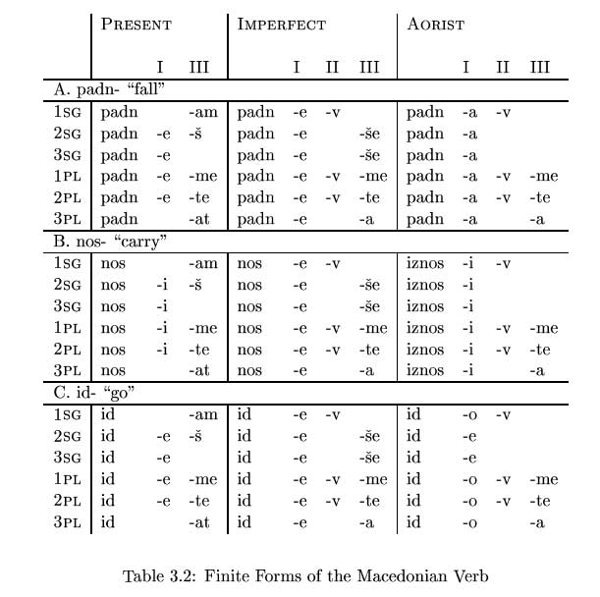
Macedonian verb paradigm

Slide 25
Syntax
How are words arranged to form sentences? *I milk like I saw the man on the hill with a telescope.
The study of rules which reveal the structure of sentences (typically tree-based)
A “pre-processing step” for semantic analysis
Common terms: Subject, Predicate, Object, Verb phrase, Noun phrase, Prepositional phr., Head, Complement, Adjunct,…

Slide 26
Example of a phrase structure and a dependency tree

Slide 27
Examples of recent work on Slovene
sloWNet: semantic lexicon
Resources of the project „Communication in Slovene“, http://eng.slovenscina.eu/
Sloleks: large inflectional lexicon
ssj500k: hand annotated corpus: PoS tags, lemmas, dependencies, named entities
ccGifafida, ccKRES: reference PoS tagged and lemmatised corpora
GOS: speech corpus, Šolar: language mistakes and corrections, …
IMP resources of historical Slovene:
goo300k: hand-annotated corpus: modernised words, PoS tags, lemmas
Lexicon of historical forms
Digital library / automatically annotated corpus
Other corpora

