Slide 1
Advanced Language Technologies Information and Communication Technologies Module "Knowledge Technologies" Jožef Stefan International Postgraduate School Winter 2011 / Spring 2012
Lecture II. Computer Corpora
Tomaž Erjavec

Slide 2
Overview of the lecture
Background
Corpus compilation and markup
Morphosyntactic tagging

Slide 3
Background
What is a corpus?
Using corpora
Characteristics of a corpus
Typology of corpora
History
Slovene language corpora

Slide 4
A corpus is:
a large collection of texts
in digital format
language “as it is”
a sample of the language it is meant to represent
used for describing language (descriptive/empirical linguistics)
for computer scientists: a dataset

Slide 5
A more precise definition
Corpus (plural corpora) is Latin for body
Guidelines of the Expert Advisory Group on Language Engineering Standards, EAGLES:
Corpus : A collection of pieces of language that are selected and ordered according to explicit linguistic criteria in order to be used as a sample of the language.
Computer corpus : a corpus which is encoded in a standardised and homogeneous way for open-ended retrieval tasks. Its constituent pieces of language are documented as to their origins and provenance.

Slide 6
Using corpora
Applied linguistics:
Lexicography: making dictionaries (first users of corpora)
Translation studies: translation equivalents with contexts translation memories, machine aided translations
Language learning: real-life examples, curriculum development
Corpus linguistics:
linguistics based not on introspection, but on observation of real data
Language technology:
testing set for developed methods
training set for inductive learning (statistical Natural Language Processing)

Slide 7
Characteristics of a (good) corpus
Quantity: the bigger, the better
Quality : the texts are authentic; the mark-up is validated
Simplicity: the computer representation is understandable, with the mark-up easily separated from the text
Documented: the corpus contains bibliographic and other meta-data

Slide 8
Typology of corpora I.
Medium:
written language
spoken language (spoken, but in writing / transcription)
speech corpora (actual speech signal)
Content:
reference corpora (representative), e.g. BNC
sub-language corpora (specialised), e.g. COLT
Structure:
corpora with integral texts
corpora or of text samples (historical and legal reasons) e.g. Brown

Slide 9
Typology of corpora II
Time:
static corpora
monitor corpora (language change)
Languages:
monolingual corpora
multilingual parallel corpora (e.g. Hansard, Europarl, JRC Acquis)
multilingual comparable corpora
Annotation:
plain text corpora
annotated corpora

Slide 10
Reference corpora
Characteristics:
a sample of the “complete” language
large, expensive, detailed and explicit design criteria
typically of contemporary language
documented and annotated
legally clean, available (but usu. only via a concordancer)
Criteria for including texts:
representativeness: corpus includes “all” text types
balance: the sizes of text type samples are in proportion to their “importance” for the speakers of the language
methodology v.s. practical constraints

Slide 11
History of corpora
First milestones: Brown (1 million words) 1964; LOB (also 1M) 1974
The spread of reference corpora: Cobuild Bank of English (monitor, 100..200..M) 1980; BNC (100M) 1995; Czech CNC (100M) 1998; Croatian HNK (100M) 1999...
EU corpus oriented projects in the '90: NERC, MULTEXT, MULTEXT-East,...
Language resources brokers: LDC 1992, ELRA 1995
Web as Corpus (2000..): ukWaC, itWaC, … slWaC
more, larger, for more languages, with diverse annotations: EUROPARL, JRC-ACQUIS, PDT, …

Slide 12
Slovene language corpora
The „FIDA“ monolingual reference corpora (FF, IJS, DZS, Amebis):
FIDA, 1998: 100M, ambiguous annotations
FidaPlus, 2006: 600M, unambiguous
Gigafida, 2012: 1000M, adds Web materials
Freely available training sets:
IJS, FF: JOS corpora (jos100k, jos1M)
SSJ project: ccFida, ssj400k
Parallel corpora:
IJS: MULTEXT-East 1998-, SVEZ-IJS, 2004, JRC-ACQUIS, 2006
SVEZ: EuroKorpus
FF: TRANS, 2002
Speech corpora:
Laboratory for Digital Signal Processing, University of Maribor: SpeechDat, ONOMASTICA...
Laboratory of Articifical Perception, Systems and Cybernetics, University of Ljubljana: SQEL, GOPOLIS,...

Slide 13
II. Compilation and markup of corpora
Steps in the preparation of a corpus
What annotation can be added to the text
Computer coding of corpora
Markup methods

Slide 14
Before making your own corpus
check if an appropriate corpus is already available
google
corpora@lists.uib.no
LDC, ELRA

Slide 15
Steps in the preparation of a corpus
Choosing the component texts and acquiring digital originals
Up-translation to standard format
Linguistic annotation
Documentation
Use
Dissemination

Slide 16
Getting the text
Choosing the component texts: linguistic and non-linguistic criteria; availability; simplicity; size
Copyright sensitivity of source (financial and privacy considerations); agreement with providers; usage, publication
Acquiring digital originals OCR; digital originals; Web
BootCat

Slide 17
Processing
Conversion to common format consistency; character set encodings; structure
Web as Corpus: Wacky tools
Documentation e.g. TEI header; Open Archives etc.
Linguistic annotation language dependent methods; errors

Slide 18
Use and dissemination
Using the corpus:
concordancer (linguists) e.g Gigafida, SKE, iKorpus, JOS, IMP
statistics extraction
development of new methods for analysis
Dissemination:
legalities (source copyright, corpus use agreement)
mode: concordancer or dataset

Slide 19
Computer coding of corpora
Encoding must ensure
durability
interchange between computer platforms
interchange between applications
Basic standard: XML
companion standards: W3C Schema, ISO Relax NG, XSLT, XPath, XQuery, ...
XML vocabulary of annotations of arbitrary texts: Text Encoding Initiative, TEI
ISO TC 37 „Terminology and other language resources“: many standards for text encoding

Slide 20
Corpus annotation
Annotation = interpretation
Documentation about the corpus (example)
Document structure (example)
Basic linguistic markup: sentences, words (example), punctuation, abbreviations (example)
Lemmas and morphosyntactic descriptions (example)
Syntax (example)
Alignment (example)
Terms, semantics, anaphora, pragmatics, intonation,...

Slide 21
Example: TEI header
<?xml version="1.0" encoding="utf-8"?>
<TEI xmlns="http://www.tei-c.org/ns/1.0" xml:lang="sl" xml:id="FPG_00008-1847">
<teiHeader xml:lang="sl">
<fileDesc>
<titleStmt>
<title>AHLib: Zschokke, Heinrich. "Čujte, čujte, kaj žganje dela!" (1847)</title>
<principal>
<name>Erich Prunč, Univerza Karl-Franzens v Gradcu</name>
</principal>
<respStmt>
<name>Tomaž Erjavec, Institut "Jožef Stefan"</name>
<resp>Računalniška obdelava</resp>
</respStmt>
</titleStmt>
<editionStmt>
<edition>1.0</edition>
</editionStmt>
<extent>124 pp</extent>
…

Slide 22
Example: text structure
<quote id="Osl.1.8.18" rend="center;it">
<lg id="Osl.1.8.18.1">
<l id="Osl.1.8.18.1.1">Tam pod kostanjevim drevesom</l>
<l id="Osl.1.8.18.1.2">izdala si me,</l>
<l id="Osl.1.8.18.1.3">izdal sem te,</l>
<l id="Osl.1.8.18.1.4">ne da bi trenila z očesom.</l>
</lg>
</quote>
<p id="Osl.1.8.19">
<s id="Osl.1.8.19.1">Trije možje se niso niti ganili.</s>
<s id="Osl.1.8.19.2">Toda ko je <name>Winston</name> znova pogledal v Rutherfordov propadli obraz, je opazil, da so njegove oči polne solz.</s> ...

Slide 23
Example: morphosyntactic tagging
<s id="Osl.1.2.2.1">
<w lemma="biti" ana="#Vcps-sma">Bil</w>
<w lemma="biti" ana="#Vcip3s--n">je</w>
<w lemma="jasen“ ana="#Afpmsnn">jasen</w><pc>,</pc>
<w lemma="mrzel" ana="#Afpmsnn">mrzel</w>
<w lemma="aprilski" ana="#Aopmsn">aprilski</w>
<w lemma="dan" ana="#Ncmsn">dan</w>
<w lemma="in" ana="#Ccs">in</w>
<w lemma="ura" ana="#Ncfpn">ure</w>
<w lemma="biti" ana="#Vcip3p--n">so</w>
<w lemma="biti" ana="#Vmps-pfa">bile</w>
<w lemma="trinajst" ana="#Mcnpnl">trinajst</w><pc>.</pc>
</s>

Slide 24
Example: alignment
<linkGrp id="Oslen.1" type="body" targtype="s" domains="Oen Osl">
<link xtargets="Osl.1.2.2.1 ; Oen.1.1.1.1">
<link xtargets="Osl.1.2.2.2 ; Oen.1.1.1.2">
<link xtargets="Osl.1.2.3.1 ; Oen.1.1.2.1">
<link xtargets="Osl.1.2.3.2 ; Oen.1.1.2.2">
...
<link xtargets="Osl.1.2.6.5 ; Oen.1.1.5.5">
<link xtargets="Osl.1.2.6.6 ; Oen.1.1.5.6 Oen.1.1.5.7">
<link xtargets="Osl.1.2.6.7 ; Oen.1.1.5.8">
...

Slide 25
Methods for linguistic markup
hand annotation: documentation, first steps generic (XML, spreadsheet) or specialised editors
semi-automatic: morphosyntactic and other linguistic annotation cyclic approach: machine, hand, validate, correct, machine, ...
machine, with hand-written rules: tokenisation regular expression
machine, with inductive models : "supervised learning"; HMMs, decision trees, inductive logic programming,...
machine, with inductively built models from un-annotated data: "unsupervised leaning"; clustering techniques
overview of the field

Slide 26
III. Morphosyntactic tagging
Better known as part-of-speech (PoS) tagging
Tagging is the task of labeling each word in a sequence of words with its appropriate part-of-speech
Words are often ambiguous with respect to their POS:
saw → singular noun „I brought a saw“
saw → past tense of verb „I saw a tree“
Purposes and applications (examples):
pre-processing step for further analyses:
lemmatisation
syntactic structure, etc.
text indexing, e.g. nouns are more useful than verbs
pronunciation in speech processing

Slide 27
Steps in tagging
for each word token in text the tagger needs to know all its possible tags (ambiguity class) → a morphological lexicon
given the context in which the word appears in, the tagger must decide in the correct tag:
he saw/V a man carrying a saw/N
so, tagging performs limited syntactic disambiguation

Slide 28
Example: Penn Treebank
Under/IN the/DT proposal/NN ,/, Delmed/NNP would/MD issue/VB about/IN 123.5/CD million/CD additional/JJ Delmed/NNP common/JJ shares/NNS to/TO Fresenius/NNP at/IN an/DT average/JJ price/NN of/IN about/IN 65/CD cents/NNS a/DT share/NN ,/, though/IN under/IN no/DT circumstances/NNS more/JJR than/IN 75/CD cents/NNS a/DT share/NN ./.

Slide 29
PoS taggers
Most taggers induce the language model from a hand-annotated corpus
Typically, two resources are induced:
lexicon, giving the ambiguity class of a word and their frequencies in the training corpus
tag n-grams

Slide 30
Tagging with Markov Models
Sequence of tags in a text is regarded a Markov chain
Limited horizon: A word’s tag only depends on the previous tag: p(x_{i+1} = t^{j} | x₁, ..., x_{i}) = p (x_{i+1} = t^{j} | x_{i})
Time invariant: This dependency does not change over time: p(x_{i+1} = t^{j} | x_{i}) = p(x₂ = t^{j} | x₁)
Task: Find the most probable tag sequence for a sequence of words
Maximum likelihood estimate of tag t^{k} following t^{j}: p(t^{k} | t^{j}) = f(t^{j},t^{k}) / f(t^{j})
Optimal tags for a sentence: t´_{1,n} = arg max p(t_{1,n} | w_{1,n}) = Π p(w_{i} | t_{i}) p(t_{i} | ti₋₁)

Slide 31
Most popular Markov model tagger
TnT (Trigrams ‘n Tags)
induces lexicon and tag trigrams from the training corpus
has heuristics to tag unknown words
has no problem with large tagsets
fast in training and tagging
freely available for non-commercial use
but only as a Linux executable
OS alternative: hunpos

Slide 32
Yet another Tagger
For a while, trying out new approaches to tagging was in fashion
Maximum Entropy taggers
Support Vector Machine taggers
Memory based taggers
…

Slide 33
Tagsets
A tagset is a set of part-of-speech tags
Classical 8 classes (Thrax, 100 BC): noun, verb, article, participle, pronoun, preposition, adverb, conjunction
But tagset typicaly use more tags than that!
Criteria:
specifiability: degree to which humans use the tagset uniformly on the same text
accuracy: evaluation of output on tagged text
suitability for intended application

Slide 34
Tagsets for English
For English, there exist several tagsets: Brown, CLAWS, Penn, …
English tagsets include PoS + some other morphological (inflectional) properties: 30-80 tags
Penn Treebank Tagset for English: 37 tags, e.g.
JJ adjective, positive
JJR adjective, comparative
JJS adjective, superlative
NN non-plural common noun
NNS plural common noun
NNP non-plural proper name
NNPS plural proper name
IN preposition
…

Slide 35
Morphosyntactic tagsets
For inflectionally rich languages (e.g. Slavic), tagsets contain much more information than just PoS
Slovene, Czech, etc. > 1,000 different morphosyntactic tags
gender, number, case, animacy, definiteness, …
Efforts to standardise tagsets across languages:
Eagles
MULTEXT
MULTEXT-East

Slide 36
MULTEXT-East
EU project in ’90s: development of language resources for Central and East-European languages
Several later releases, V4 in 2010 (17 languages)
Development of morphosyntactic specifications, lexica and annotated corpus
Parallel annotated corpus: Orwell’s 1984
Web site: http://nl.ijs.si/ME/

Slide 37
MULTEXT-East morphosyntactic specifications
Specify
what morphosyntactic features particular languages distinguish,
what their names and values are,
how they can be mapped to tags (morphosyntactic descriptions, MSDs)
e.g. that Ncms is:
a valid for Slovene
is equivalent to PoS:Noun, Type:common, Gender:masculine, Number:singular
http://nl.ijs.si/ME/V4/msd/html/

Slide 38
JOS project
JOS language resources are meant to facilitate developments of human language technologies and corpus linguistics for the Slovene language
Morphosyntactic specifications
Two annotated corpora (morphosyntactic descriptions and lemmas)
jos100k (hand validated)
jos1M (partially hand validated)
Sampled from FidaPLUS corpus
jos100k: syntactic and semantic levels of linguistic description
Two web services
concordancer
text annotation tool
Encoded in TEI P5
Freely available (CC): http://nl.ijs.si/jos/

Slide 39
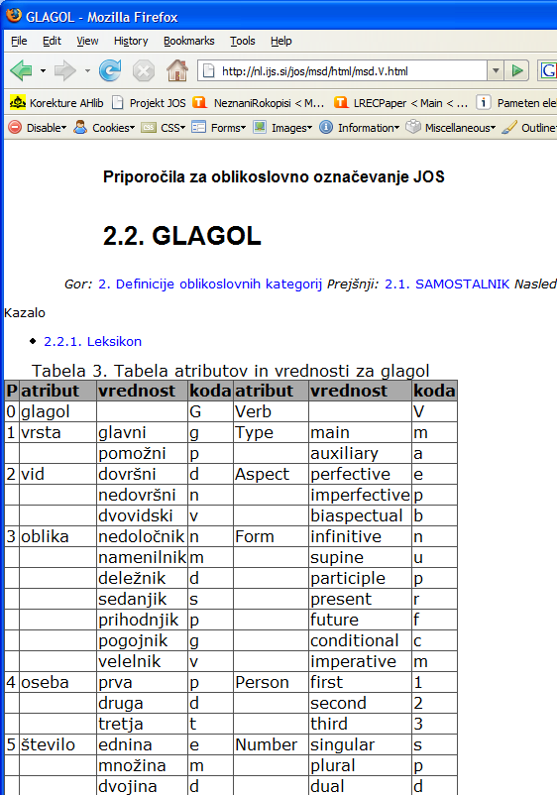
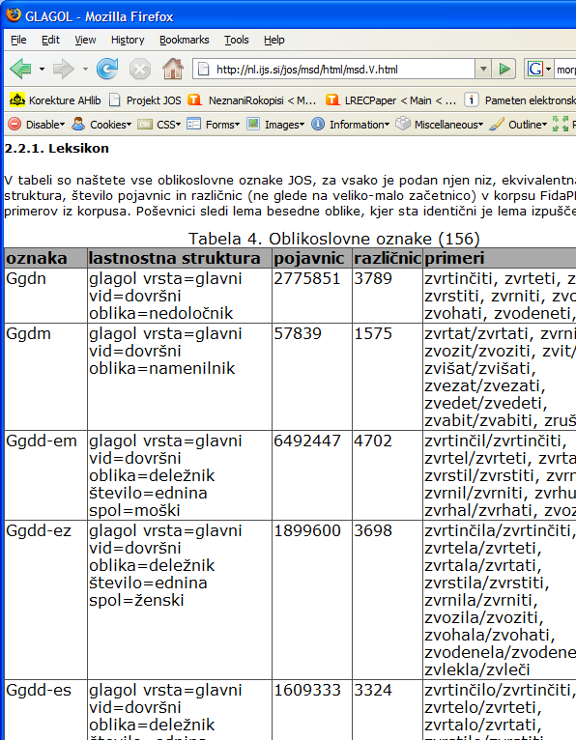

Slide 40
jos100k encoding
<s xml:id="F0020003.557.2">
<w xml:id="F0020003.557.2.1" lemma="ta" msd="Zk-sei">To</w><S/>
<w xml:id="F0020003.557.2.2" lemma="biti" msd="Gp-ste-n">je</w><S/>
<term type="sloWNet" sortKey="kraj” key="ENG20-08114200-n">
<w xml:id="F0020003.557.2.3" lemma="turističen„
msd="Ppnmein">turističen</w><S/>
<w xml:id="F0020003.557.2.4" lemma="kraj" msd="Somei">kraj</w>
</term>
<c xml:id="F0020003.557.2.5">.</c><S/>
</s>
<linkGrp type="syntax" targFunc="head argument" corresp="#F0020003.557.2">
<link type="ena" targets="#F0020003.557.2.2 #F0020003.557.2.1"/>
<link type="modra" targets="#F0020003.557.2 #F0020003.557.2.2"/>
<link type="dol" targets="#F0020003.557.2.4 #F0020003.557.2.3"/>
<link type="dol" targets="#F0020003.557.2.2 #F0020003.557.2.4"/>
<link type="modra" targets="#F0020003.557.2 #F0020003.557.2.5"/>
</linkGrp>

Slide 41
Processing Historical Language
Interesting for diachronic linguistics and better access to digital libraries
Problems:
difficult to obtain good transcriptions
great variation in spelling
no resources for tool training
Historical slv:
Late standardisation (XIX ≠ XX)
Before 1850: ſ ſh s sh z zh → s š z ž c č
No corpora/lexica of historical Slovene

Slide 42
Background
AHLib (2004–08) Deutsch-slowenische/kroatische Übersetzung 1848–1918
Scans + correction + (lemmatisation) of ger→slv books
AAS & Karl-Franzens University, Graz (prof. Erich Prunč)
JSI: correction & lemmatisation environment
EU IP IMPACT (ext. 2010–2011)
Better OCR for historical texts
NUK: GTD transcriptions
JSI: (semi)manual lexicon construction
Google award (2011+2012) Developing language models for historical Slovene
ZRC SAZU: transcriptions of old texts
JSI: annotating a corpus of XIXth century Slovene

Slide 43
Producing the goo300k corpus
Representative & balanced, sampled
Corpus element: unbroken & contiguous text from 1 page
Sampled by decade & text
Target size: 1,000 pages (~300,000 tokens)
Encoded in TEI P5
Automatically annotated
Tool for manual annotation: IMPACT INL Cobalt
Annotator training & management: May
Manual correction: June–November
Fixing bugs & packaging: December - April

Slide 44
Annotation tool
Approach:
Modernise, then process as contemporary language
Language independent (trainable) modules
Steps:
Tokenisation (mlToken)
Transcription (Vaam)
Tagging (TnT)
Lemmatisation (CLOG)
= ToTrTaLe
Pipeline in Perl
TEI P5 I/O

Slide 45
Extracted lexicon
Also encoded in TEI
Lemma oriented
Useful for enabling full-text searching in DL
Also for humans: look up of extinct words

Slide 46
Conclusions
What is a corpus
How to make it
How to annotate it
Case studies: MULTEXT-East, JOS, IMP

